Slide 1

Chapter 3 – Foundation II
Prepared by: Shier Nee, SAW

Slide 2
Outline
Decision Theory
Information Theory
Optimization
Notes:
Uni – 45 min, multi – 30min, break (15min), statistic – 1.5hr

Slide 3
Decision Theory
Decision Theory
Information Theory
Optimization
A set of quantitative methods for reaching optimal decisions.
Quoted from The Editors of Encyclopaedia Britannica
Is concerned with the reasoning underlying an agent’s choices, whether this is a mundane choice between taking the bus or getting a taxi, or a more far-reaching choice about whether to pursue a demanding political career.
Quoted from Stanford Encyclopedia of Philosophy
How can we decide which action is best?
This is where Bayesian decision theory comes in.

Slide 4
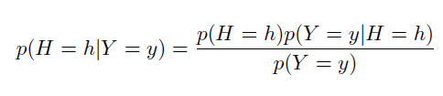
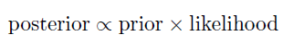
Bayes’s Theorem
Decision Theory
Information Theory
Optimization
Describes the probability of an event, based on prior knowledge of conditions that might be related to the event.
Bayes’ rule itself is very simple: it is just a formula for computing the probability distribution over possible values of an unknown (or hidden) quantity H given some observed data Y = y:
Prior distribution
Likelihood
Posterior distribution / new belief state
Marginal Likelihood

Slide 5
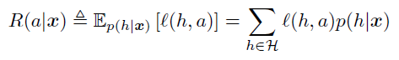
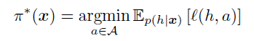
Decision Theory
Decision Theory
Information Theory
Optimization
We assume the decision maker, or agent, has a set of possible actions, A, to choose from.
Example: hypothetical doctor treating someone who may have COVID
Actions, a:
Do nothing
Give patient expensive drugs with bad side effect but can save their life.
Every action has cost and benefits → depend on underlying state of nature h∈𝓗.
Encode this information to loss function ℓ(h, a), loss when we incur if action a ∈ A is taken at state of nature, h ∈ 𝓗.
We can compute posterior expected loss or risk for each possible action.
Notes:
Minimize risk to decide which action to take.

Slide 6
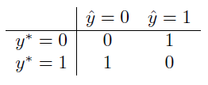
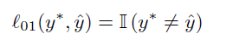
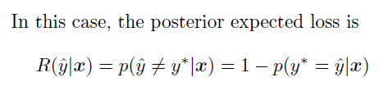
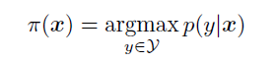
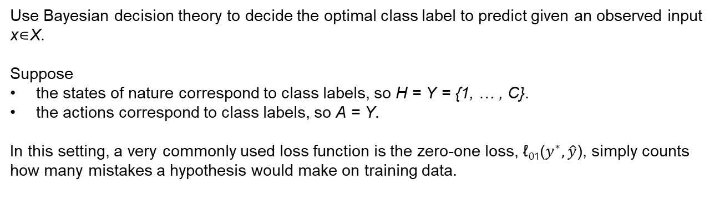
Classification- Zero-one loss
Decision Theory
Information Theory
Optimization
Use Bayesian decision theory to decide the optimal class label to predict given an observed input x∈X.
Suppose
the states of nature correspond to class labels, so H = Y = {1, … , C}.
the actions correspond to class labels, so A = Y.
In this setting, a very commonly used loss function is the zero-one loss, ℓ₀₁($y^{∗}, \hat{y}$), simply counts how many mistakes a hypothesis would make on training data.
Mode of the posterior distribution or maximum a posteriori or MAP estimate

Slide 7
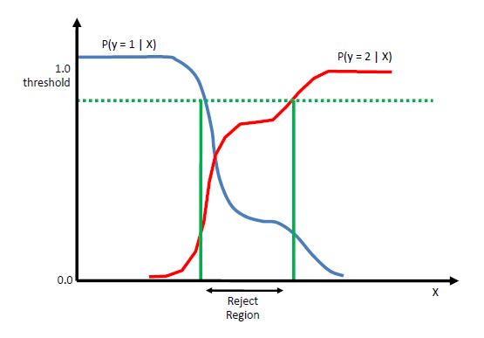
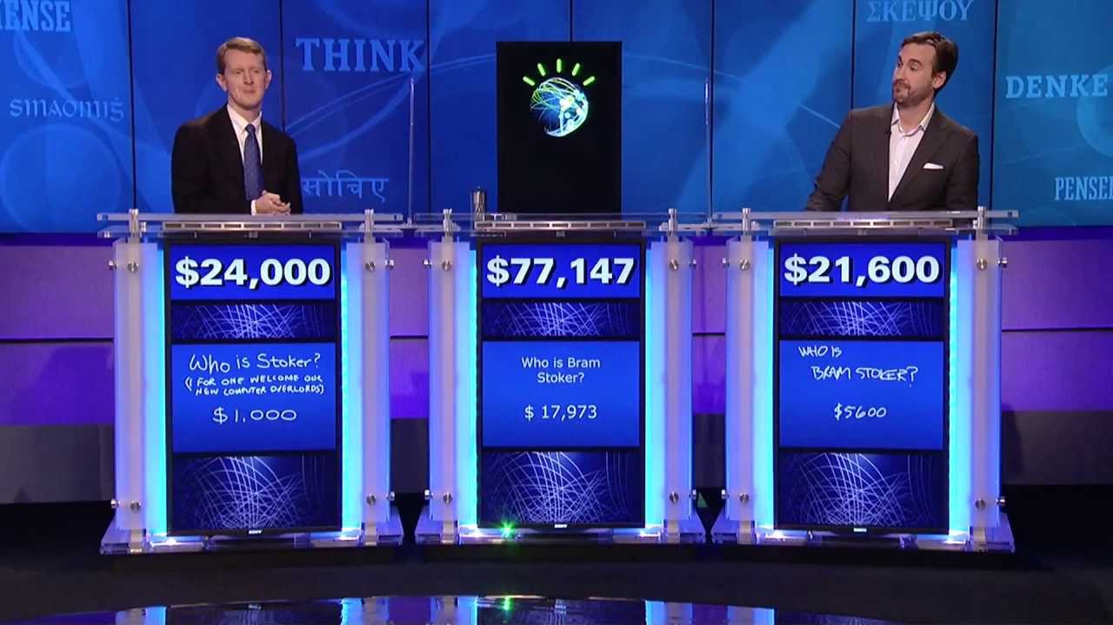
Classification- Rejection option
Decision Theory
Information Theory
Optimization
In some cases, we may be able to say “I don’t know” instead of returning an answer that we don’t really trust; this is called picking the reject option.
This is particularly important in domains such as medicine and finance where we may be risk averse
https://www.youtube.com/watch?v=P18EdAKuC1U

Slide 8
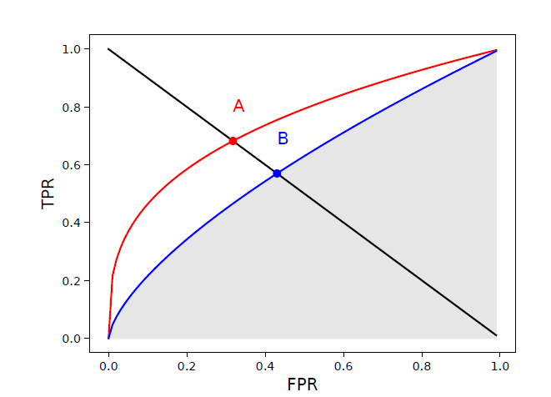
Classification- ROC curve
Decision Theory
Information Theory
Optimization
Area under ROC curve is computed.
The higher the AUROC, the better the classifier.

Slide 9
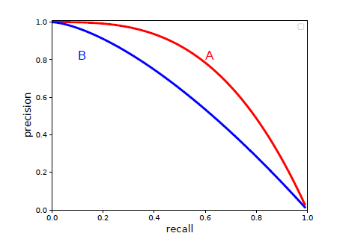
Classification- Precision-Recall Curve
Decision Theory
Information Theory
Optimization
Area under PR curve is computed.
The higher the AUC of PR curve, the better the classifier.
F1 – score
Mostly used in information retrieval (query)

Slide 10


Join at slido.com #385487
ⓘ Start presenting to display the joining instructions on this slide.

Slide 11
If we have imbalanced class, is AUROC (TPR vs FPR) reliable?
ⓘ Start presenting to display the poll results on this slide.

Slide 12
If we have imbalanced data, is AUROC (Precision vs Recall) reliable?
ⓘ Start presenting to display the poll results on this slide.

Slide 13
Decision Theory
Information Theory
Optimization
Let’s go to colab to find out.

Slide 14
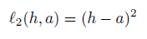
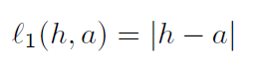
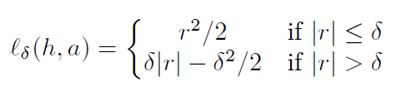
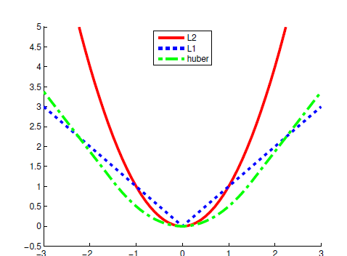
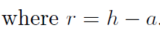
Regression – Loss function
Decision Theory
Information Theory
Optimization
L2 loss
L1 loss
Huber loss
Sensitive to outlier

Slide 15
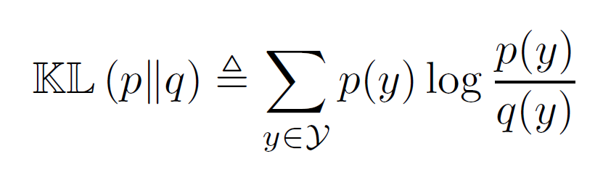
Compare Distribution
Decision Theory
Information Theory
Optimization
Kullback Leibler divergence, or KL divergence is a measure of how one probability distribution is different from a second, reference probability distribution.
Notes:
P = true distribution
Q = predicted distribution

Slide 16
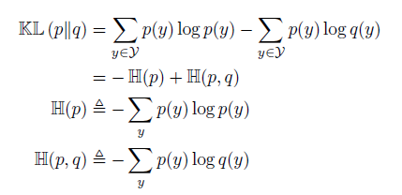
KL divergence
Decision Theory
Information Theory
Optimization
Entropy;
Max if the distribution p is uniform
Zero if p is a delta function
Cross-Entropy
If KL = 0 correctly predict the probabilities of all possible future events
Notes:
P = true distribution, Q = predicted distribution
Minimize KL divergence. H(p) is constant, we can just minimize the cross entropy

Slide 17

Hypothesis Testing
Decision Theory
Information Theory
Optimization
Suppose we have two hypotheses or models, commonly called the null hypothesis, M₀, and the alternative hypothesis, M₁, and we want to know which one is more likely to be true.
The optimal decision to pick alternative hypothesis iff
P(M₁|D) > P(M₀|D)
$\frac{\text{P}\text{(}\text{M}\text{1}\text{|}\text{D}\text{)}}{\text{P}\text{(}\text{M}\text{0}\text{|}\text{D}\text{)}}>1$
Notes:
P = true distribution, Q = predicted distribution
Minimize KL divergence. H(p) is constant, we can just minimize the cross entropy

Slide 18
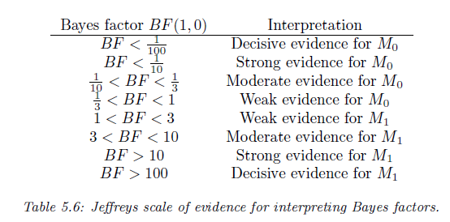


Hypothesis Testing
Decision Theory
Information Theory
Optimization
If we use uniform prior p(M₀) = p(M₁) = 0.5, the decision rule becomes
$\frac{\text{P}\text{(}\text{D}\text{ | }\text{M}\text{1}\text{)}}{\text{P}\text{(}\text{D}\text{ | }\text{M}\text{0}\text{)}} >1$
Bayes Factor = ratio of marginal likelihood of two models
$B_{1,0}≜ \frac{\text{P}\text{(}\text{D}\text{ | }\text{M}\text{1}\text{)}}{\text{P}\text{(}\text{D}\text{ | }\text{M}\text{0}\text{)}}$
Notes:
P = true distribution, Q = predicted distribution
Minimize KL divergence. H(p) is constant, we can just minimize the cross entropy

Slide 19
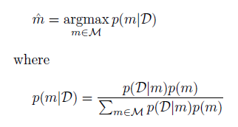
Bayesian Model Selection
Decision Theory
Information Theory
Optimization
Suppose we have a set M of more than 2 models, and we want to pick the most likely.
The optimal action is picking the most probable model

Slide 20
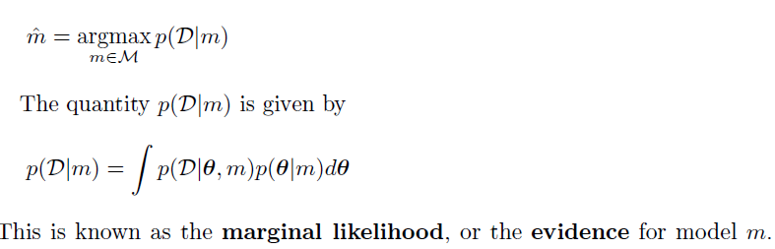
Bayesian Model Selection
Decision Theory
Information Theory
Optimization
If the prior over models is uniform,, p(m) = 1/|M|, then the MAP is given by
prior
Notes:
MAP = maximum a posteriori
We can think of if the parameter of the model give high probability to the given datasets, weighted by the prior, it is probably a good model

Slide 21
Occam’s razor
Decision Theory
Information Theory
Optimization
Consider two models, a simple one, m₁, and a more complex one, m2.
Suppose that both can explain the data by suitably optimizing their parameters.
Intuitively we should prefer m₁, since it is simpler and just as good as m₂.
This principle is known as Occam’s razor

Slide 22

Bayesian Occam’s razor effect
Decision Theory
Information Theory
Optimization
Intuition from Squid Game
Complex Model
Simple Model
Many θ averaged over the parameter space
Few θ averaged over the parameter space

Slide 23
Decision Theory
Decision Theory
Information Theory
Optimization
A set of quantitative methods for reaching optimal decisions.
Bayesian Statistics
AUROC curve
Precision Recall Curve / F1 score
Uses Bayes factor
Choose model with larger marginal likelihood

Slide 24
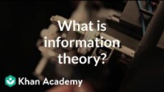
Information Theory
Decision Theory
Information Theory
Optimization

Slide 25
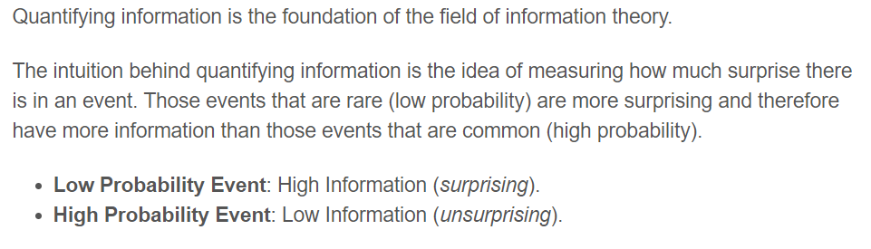
Entropy
Decision Theory
Information Theory
Optimization

Slide 26
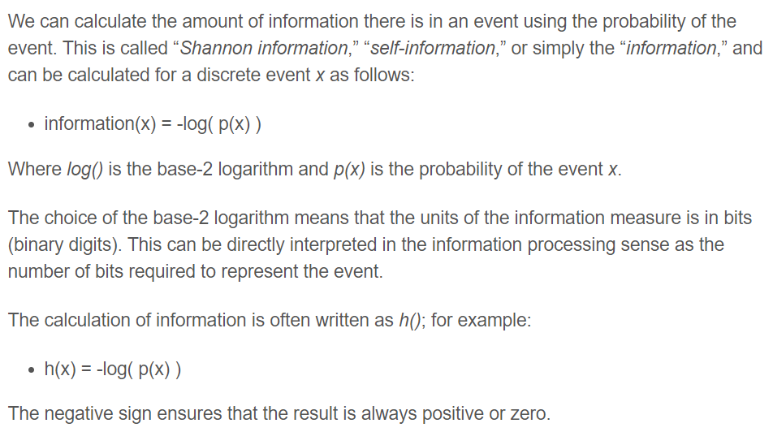
Entropy
Decision Theory
Information Theory
Optimization

Slide 27
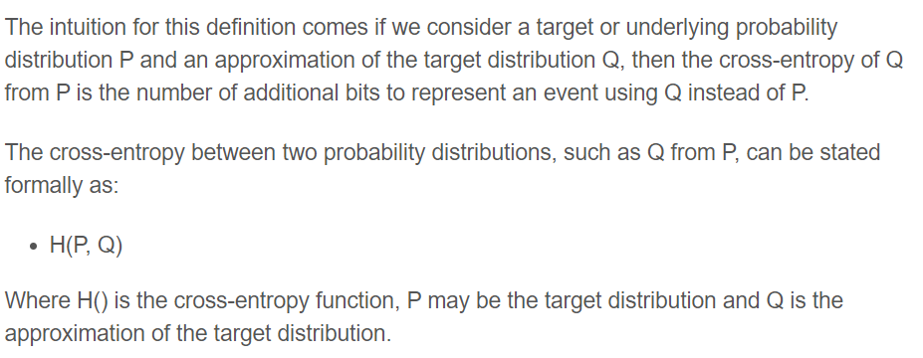
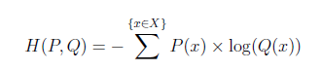
Cross Entropy
Decision Theory
Information Theory
Optimization
Calculates the number of bits required to represent or transmit an average event from one distribution compared to another distribution

Slide 28
KL divergence / Relative Entropy
Decision Theory
Information Theory
Optimization
total number of bits required to represent a message with Q instead of P
average number of extra bits required to represent a message with Q instead of P

Slide 29
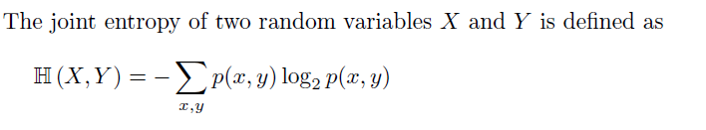
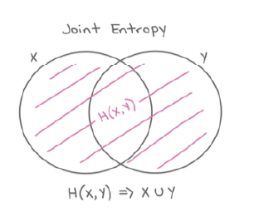
Joint Entropy
Decision Theory
Information Theory
Optimization

Slide 30
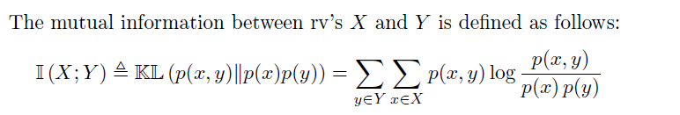
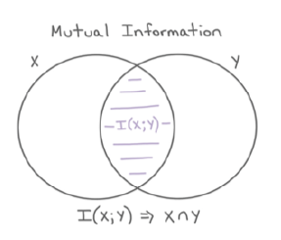
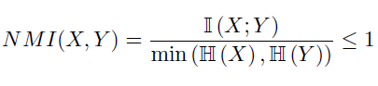
Mutual Information
Decision Theory
Information Theory
Optimization
How similar two distributions were
Used in Clustering – to measure cluster quality
Notes:
NMI = normalized Mutual information

Slide 31
Information Theory
Decision Theory
Information Theory
Optimization
Quantifying information using entropy
Cross entropy
KL divergence / Relative entropy
Joint entropy
Mutual Information
Notes:
NMI = normalized Mutual information

Slide 32
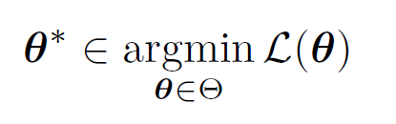
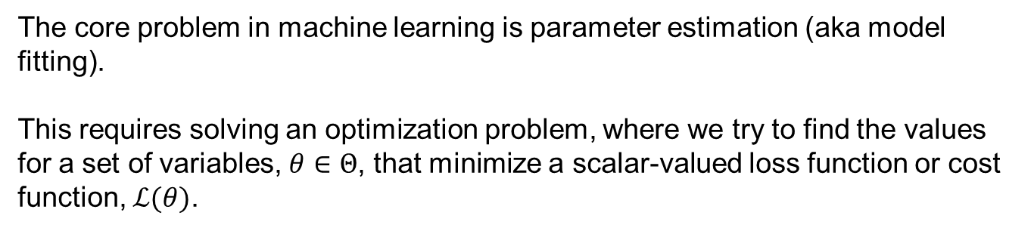
Optimization
Decision Theory
Information Theory
Optimization
The core problem in machine learning is parameter estimation (aka model fitting).
This requires solving an optimization problem, where we try to find the values for a set of variables, $θ∈Θ$, that minimize a scalar-valued loss function or cost function, $ℒ(θ)$.
Notes:
NMI = normalized Mutual information

Slide 33
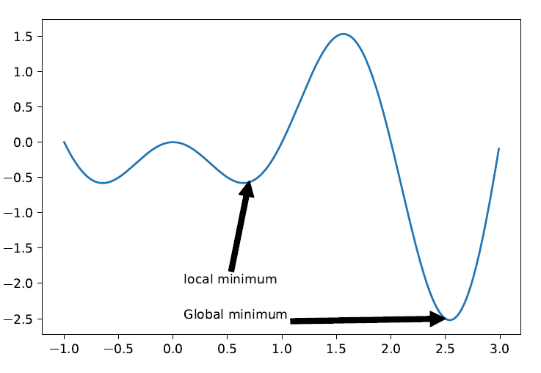
Global / Local Optimization
Decision Theory
Information Theory
Optimization
Notes:
NMI = normalized Mutual information

Slide 34
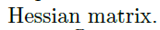
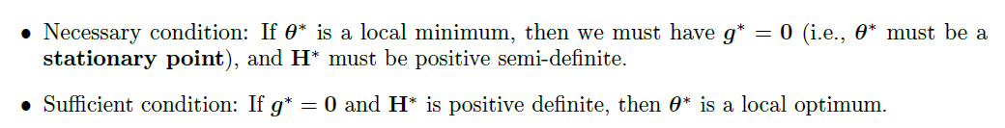
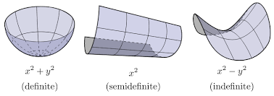
Global / Local minima
Decision Theory
Information Theory
Optimization
Notes:
NMI = normalized Mutual information

Slide 35
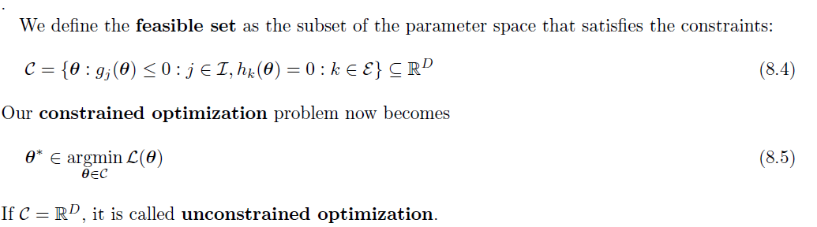
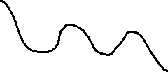
Constrained / Unconstrained Optimization
Decision Theory
Information Theory
Optimization
Inequality constraints
Equality constraints
If too many constrained → empty feasible sets
A common strategy to solve constrained problem is add penalty to the loss function such as using Lagrangian multiplier.
Notes:
NMI = normalized Mutual information

Slide 36
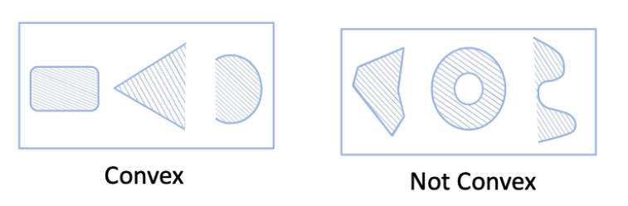
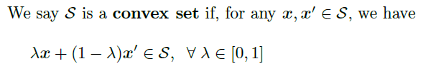
Convex / Concave Optimization
Decision Theory
Information Theory
Optimization
Notes:
NMI = normalized Mutual information

Slide 37
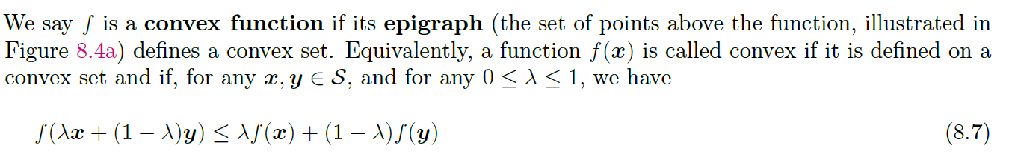
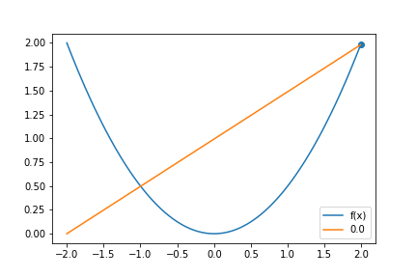
Convex Function
Decision Theory
Information Theory
Optimization
Y-axis value that fell between the domain from x and y
Straight line between (x, f(x)) and
(y, f(y)) as a function of t
Notes:
NMI = normalized Mutual information

Slide 38
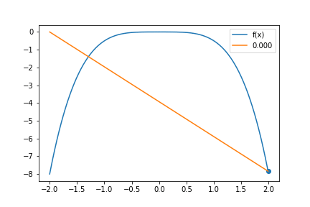
Convex Function
Decision Theory
Information Theory
Optimization
Convex
Concave
Notes:
NMI = normalized Mutual information

Slide 39
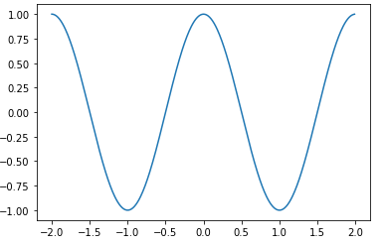
Convex Function
Decision Theory
Information Theory
Optimization
Notes:
NMI = normalized Mutual information

Slide 40

Is the graph convex or not?
ⓘ Start presenting to display the poll results on this slide.

Slide 41
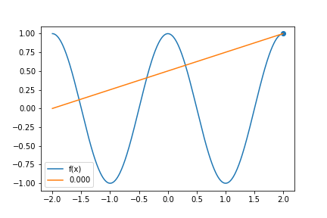
Convex Function
Decision Theory
Information Theory
Optimization
Not Convex
Notes:
NMI = normalized Mutual information

Slide 42
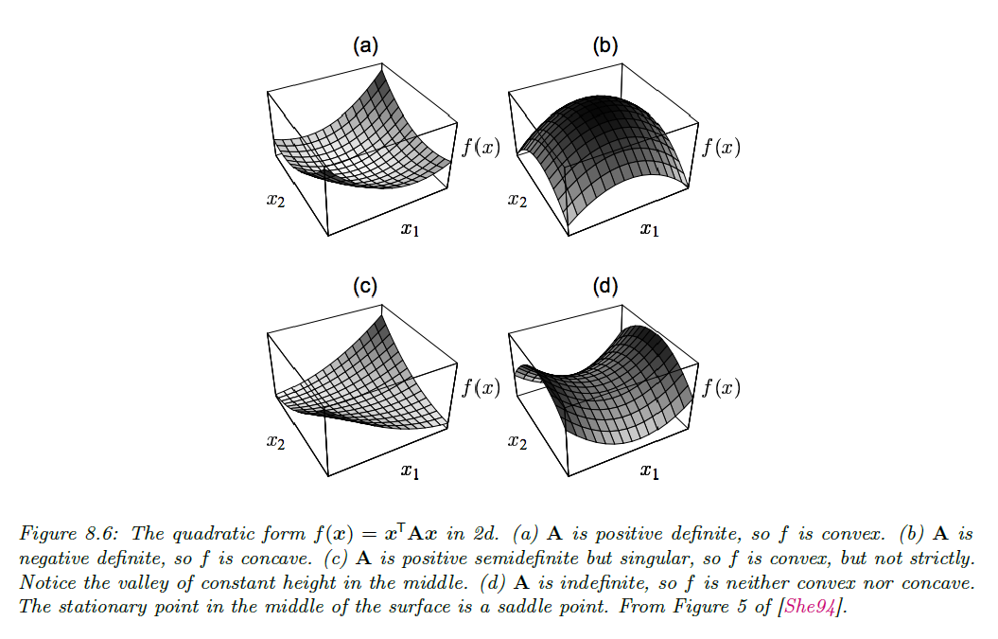
Type of Convex Function
Decision Theory
Information Theory
Optimization
Strictly convex
Strictly concave
Convex but not strictly
Neither convex nor concave → saddle point
Notes:
NMI = normalized Mutual information

Slide 43
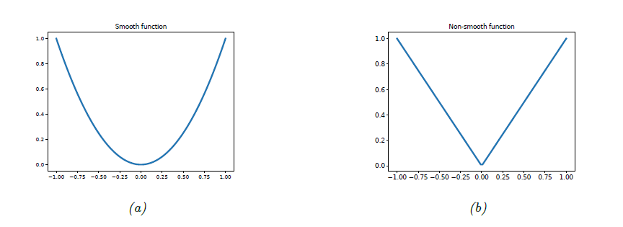

Smooth and Non-Smooth Optimization
Decision Theory
Information Theory
Optimization
Discontinuity / sharp turn
Lipschitz constant – quantify the degree of smoothness

Slide 44
First Order Method
Decision Theory
Information Theory
Optimization
Gradient descent
Step size/ learning rate
Convergence rate
Momentum Method

Slide 45




First Order Method
Decision Theory
Information Theory
Optimization
Gradient descent
Step size/ learning rate
Convergence rate
Momentum Method
Updated parameter
Descent direction
Step size
steepest descent will have global convergence iff the step size satisfies

Slide 46


First Order Method
Decision Theory
Information Theory
Optimization
Gradient descent
Step size/ learning rate
Convergence rate, μ
Momentum Method
The condition number measures how “skewed” the space is, in the sense of being far from a symmetrical “bowl”
Notes:
kappa

Slide 47

First Order Method
Decision Theory
Information Theory
Optimization
Gradient descent
Step size/ learning rate
Convergence rate
Momentum Method
momentum
Normally β=0.9, if β = 0 → gradient descent
Notes:
Gradient descent moves very slow at flat region.
move faster along directions that were previously good, and to slow down along directions where the gradient has suddenly changed, just like a ball rolling downhill

Slide 48





First Order Method – Line Search
$$f\left(x\right)=\frac{1}{20}x^{4}−\frac{2}{5}x+1$$
Decision Theory
Information Theory
Optimization
Consider we want to minimize this loss function, $f\left(θ\right)=\frac{1}{20}θ^{4}−\frac{2}{5}θ+1$
We know the min point is at $θ$* = 1.25
(compute f’($θ$) = 0)
What if we use line search (iterative method to find $θ$*)
X
$θ$*

Slide 49


First Order Method – Line Search
Decision Theory
Information Theory
Optimization
Start with random number, $θ_{t}$
$$θ_{t}$$

Slide 50


First Order Method – Line Search
Decision Theory
Information Theory
Optimization
Start with random number, $θ_{t}$
Compute the gradient at $x_{k}$
$$f^{′}(θ_{t})=\frac{f\left(θ\right)−f\left(θ_{t}\right)}{θ−θ_{t}}$$
$$θ_{t}$$

Slide 51


First Order Method – Line Search
Decision Theory
Information Theory
Optimization
Start with random number, $θ_{k}$
Compute the gradient at $x_{k}$
$$f^{′}(θ_{t})=\frac{f\left(θ\right)−f\left(θ_{t}\right)}{θ−θ_{t}}$$
If $f^{′}\left(θ_{t}\right)$ is negative, move $θ_{t}$ to the right
$$θ_{t}$$

Slide 52

First Order Method – Line Search
Decision Theory
Information Theory
Optimization
Start with random number, $θ_{k}$
Compute the gradient at $x_{k}$
$$f^{′}(θ_{t})=\frac{f\left(θ\right)−f\left(θ_{t}\right)}{θ−θ_{t}}$$
If $f^{′}\left(θ_{t}\right)$ is negative, move $θ_{t}$ to the right
If $f^{′}\left(θ_{t}\right)$is positive, move $θ_{t}$ to the left
$$θ_{t}$$

Slide 53




First Order Method – Line Search
Decision Theory
Information Theory
Optimization
Start with random number,$θ$
Compute the gradient at $x_{k}$
$$f^{′}(θ_{t})=\frac{f\left(θ\right)−f\left(θ_{t}\right)}{θ−θ_{t}}$$
If $f^{′}\left(θ_{t}\right)$ is negative, move $x_{k}$ to the right
If $f^{′}\left(θ_{t}\right)$is positive, move $x_{k}$ to the left
$$θ_{t+1 }=θ_{t}− α f′(θ_{t})$$
$$θ_{t}$$
Large step size, $α$ will overshoot
Small step size, $α$ will be very slow

Slide 54
First Order Method – Line Search
Decision Theory
Information Theory
Optimization
Slow to converge

Slide 55




Second Order Method – Newton Method
Decision Theory
Information Theory
Optimization
Approximate with non linear graph
Compute the second derivative at $x_{k}$
$$f^{′′}(θ_{k})=\frac{f\left(θ\right)−f\left(θ_{k}\right)}{θ−θ_{k}}$$
$$θ_{t+1 }=θ_{k}− α f′(θ_{k})$$
Using some algebra
$$θ_{t+1 }=θ_{k}−α\frac{1}{f^{′′}\left(θ_{k}\right)} f′(θ_{k})$$
$$θ_{k}$$
Faster convergence

Slide 56


Second Order Method – Newton Method
Decision Theory
Information Theory
Optimization
Higher dimension
H = Hessian matrix
ρ = step size
g_{t} = gradient

Slide 57




Stochastic Gradient Descent
Decision Theory
Information Theory
Optimization
Batch Gradient Descent
Stochastic Gradient Descent
$$f\left(θ\right)=\frac{1}{2m}\sum_{i=1}^{m}{{(h_{θ}\left(x^{\left(i\right)}\right)−y^{\left(i\right)})}^{2}}$$
$$cost \left(θ, (x^{\left(i\right)},y^{\left(i\right)})\right)={\frac{1}{2}(h_{θ}\left(x^{\left(i\right)}\right)−y^{\left(i\right)})}^{2}$$
Random Shuffle Data
Repeat {
for i = 1, ... , m {
}
}
$$θ_{t+1}= θ_{t} − α f′\left(θ\right)$$
Need to compute for all data,
if you have sample size, m = 1million
Very slow to update θ
$$θ_{t+1}= θ_{t} − α \frac{∂}{∂θ_{t}}cost\left(θ, (x^{\left(i\right)},y^{\left(i\right)}\right)$$
Update θ using only one data point.
Faster

Slide 58

Stochastic Gradient Descent
Decision Theory
Information Theory
Optimization
Batch Gradient Descent
Stochastic Gradient Descent

Slide 59
Decision Theory
Information Theory
Optimization
Let’s go to colab to try out SGD.

